Slide 1

Buncombe County Sheriff’s Office
Detention Bureau
PREA Statistics
2022-PRESENT
21st Century and Beyond
Notes:
Content Slide #1 for Slide Style #1

Slide 2

2026 PREA Investigations
SHERIFF QUENTIN MILLER
Notes:
ASK SOMEONE IN THE CLASS TO READ THIS OUTLOUD.
Ask what the purpose of a Mission Statement is? This will be very important in our presentation. This is where it starts and what charts the course we are on together.

Slide 3
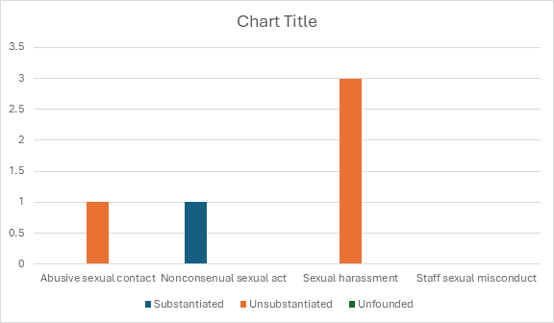
2025 PREA Statistics (5 reported cases)
SHERIFF QUENTIN MILLER
Notes:
ASK SOMEONE IN THE CLASS TO READ THIS OUTLOUD.
Ask what the purpose of a Mission Statement is? This will be very important in our presentation. This is where it starts and what charts the course we are on together.

Slide 4
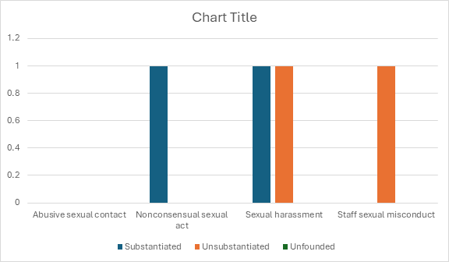
2024 PREA Statistics (4 reported cases)
SHERIFF QUENTIN MILLER
Notes:
ASK SOMEONE IN THE CLASS TO READ THIS OUTLOUD.
Ask what the purpose of a Mission Statement is? This will be very important in our presentation. This is where it starts and what charts the course we are on together.

Slide 5
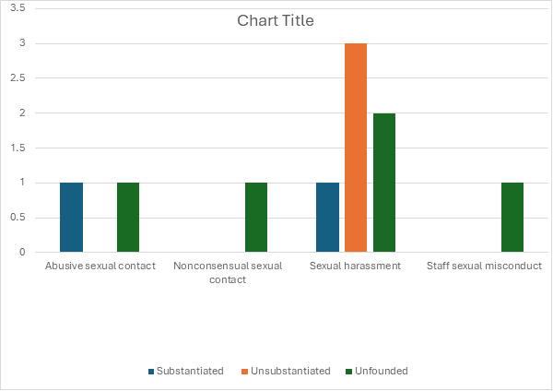
2023 PREA Statistics (10 reported cases)
SHERIFF QUENTIN MILLER
Notes:
ASK SOMEONE IN THE CLASS TO READ THIS OUTLOUD.
Ask what the purpose of a Mission Statement is? This will be very important in our presentation. This is where it starts and what charts the course we are on together.

Slide 6
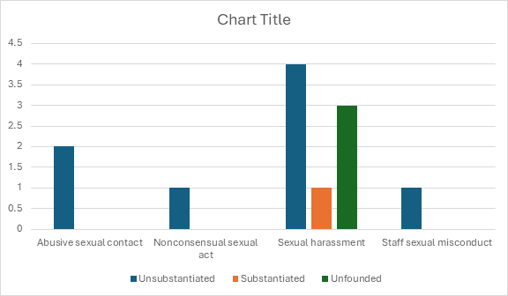
2022 PREA Statistics (12 reported cases)
SHERIFF QUENTIN MILLER
Notes:
ASK SOMEONE IN THE CLASS TO READ THIS OUTLOUD.
Ask what the purpose of a Mission Statement is? This will be very important in our presentation. This is where it starts and what charts the course we are on together.

