Slide 1

PREA Stats 2026 Updated 7 August 2026

Slide 2

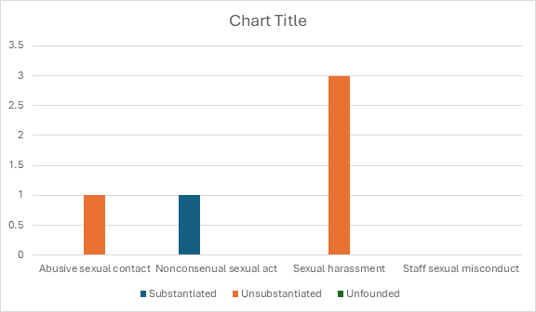



PREA Stats 2025
5 reported cases

Slide 3
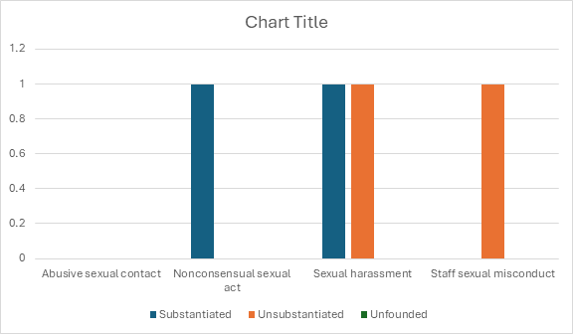
PREA Stats 2024
4 reported cases

Slide 4
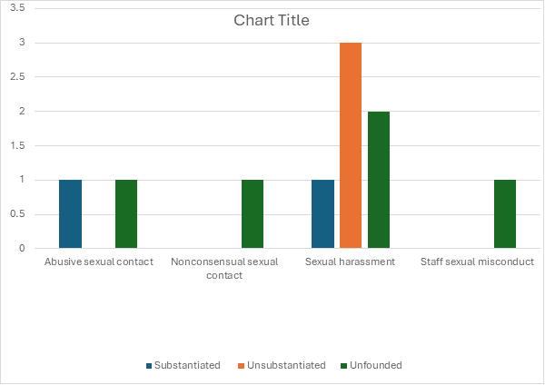
PREA Stats 2023
10 reported cases

Slide 5
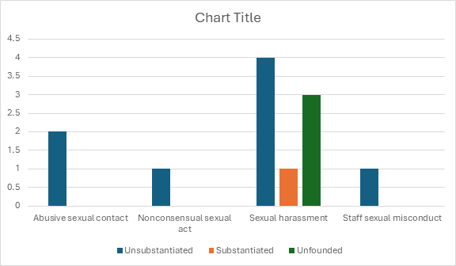
PREA Stats 2022
12 reported cases

Slide 6
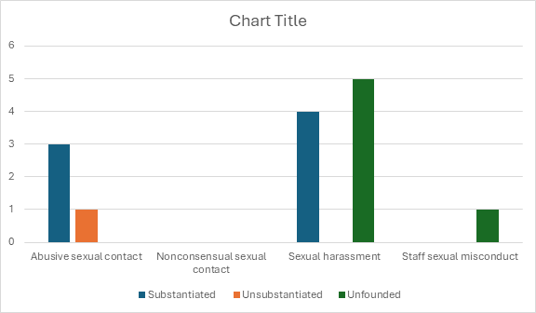
PREA Stats 2021
14 reported cases

